Slide 1
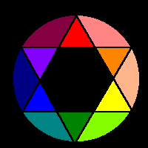
Color Theory

Slide 2
Color Theory
Color Wheel
Color Values
Color Schemes

Slide 3
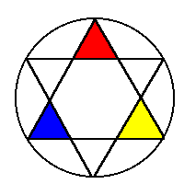
Primary Colors
Primary colors are not mixed from other elements and they generate all other colors.
Red
Yellow
Blue

Slide 4
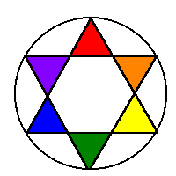
Secondary Colors
By mixing two primary colors, a secondary color is created.
Red + Yellow = Orange
Yellow + Blue = Green
Blue + Red = Purple

Slide 5
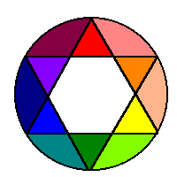
Intermediate Colors
Intermediate, or Tertiary, colors are created by mixing a primary and a secondary.
red-orange
yellow-orange
yellow-green
blue-green
blue-purple
red-purple

Slide 6

Neutral Colors
The principles of color mixing let us describe a variety of colors, but there are still many colors to explore. The neutral colors contain equal parts of each of the three primary colors. Black, white, gray and sometimes brown are considered "neutral”.

Slide 7
Color Values
Color values are the lights and darks of a color you create by using black and white (‘neutrals”) with a color. This makes hundreds of more colors from the basic 12 colors of the wheel.
white + color = tint
color + black = shade

Slide 8

Tints
Tints are lightened colors. Always begin with white and add a bit of color to the white until the desired tint is obtained. This is an example of a value scale for the tints of blue.

Slide 9

Shades
Shades are darkened colors. Always begin with the color and add just a bit of black at a time to get the desired shade of a color. This is an example of a value scale for the shades of blue.

Slide 10
Color Schemes
Color Schemes are a systematic way of using the color wheel to put colors together… in your art work, putting together the clothes you wear, deciding what colors to paint your room…..
monochromatic, complementary, analogous, warm and cool.

Slide 11
Monochromatic
“Mono” means “one”, “chroma” means “color”… monochromatic color schemes have only one color and its values. The following slide shows a painting done in a monochromatic color scheme.

Slide 12

This non-objective painting has a monochromatic color scheme - blue and the values (tints and shades) of blue.

Slide 13

Complementary
Complementary colors are opposite on the color wheel provided a high contrast - if you want to be noticed wear complementary colors!

Slide 14

This painting has complementary colors and their values - blues and oranges.

Slide 15
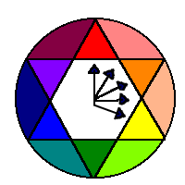
Analogous
The analogous color scheme is 3-5 colors adjacent to each other on the color wheel. This combination of colors provides very little contrast.

Slide 16
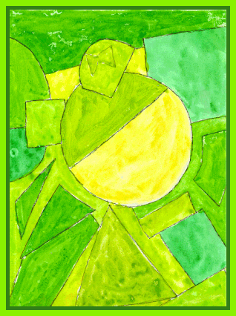
Analogous colors are illustrated here: yellow, yellow-green, green and blue-green.

Slide 17
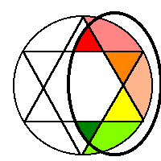
Warm
Warm colors are found on the right side of the color wheel. They are colors found in fire and the sun. Warm colors make objects look closer in a painting or drawing.

Slide 18
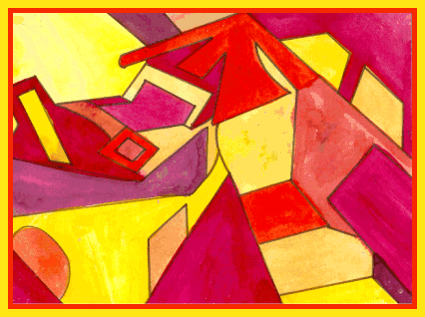
This is an illustration of the use of warm colors - reds, oranges and yellows.

Slide 19
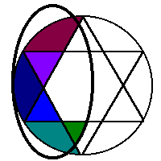
Cool
Cool colors are found on the left side of the color wheel. They are the colors found in snow and ice and tend to recede in a composition.

Slide 20

Note the cool color scheme in this painting (greens, purples and blues).

